Slide 1

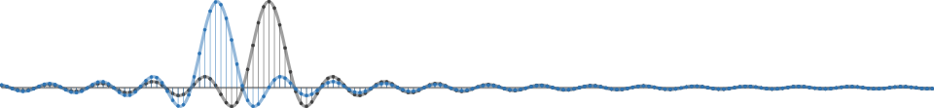
GNU Radio Workshop
Marcus Müller and Bastian Bloessl
July 2017 ▪ HAMRADIO ▪ SDR Academy ▪ Friedrichshafen, Germany

Slide 2
Master Plan
GNU Radio 101
Building an FM receiver
Using OOTs
Extending GNU Radio
Hands-On!

Slide 3
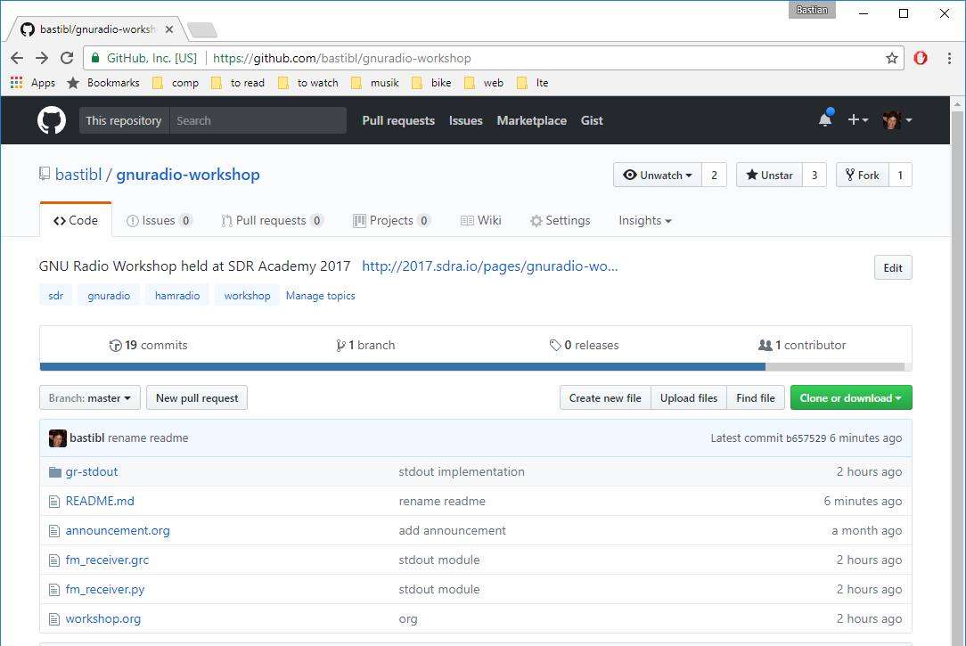
Material is Online
https://github.com/bastibl/gnuradio-workshop

Slide 4

About Us: Marcus Müller
Research Assistant @ CEL, Karlsruhe Institute of Technology
Engineer @ Ettus Research

Slide 5



About Us: Bastian Bloessl
Researcher @ Connect Center Trinity College Dublin
Engineer @ SRS Software Radio Systems

Slide 6


GNU Radio is…
A signal processing library
Designed for real-time
The software part of an SDR
Not a radio application
The tool to build your own transceivers
Matches perfectly with the ham spirit

Slide 7
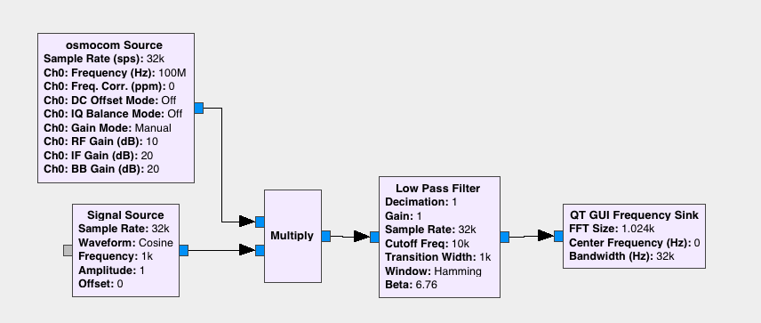
Basic Concept: Flow Graph
Transceivers are implemented as flow graphs
Similar to Simulink / schematics
Define structure and parameters of blocks

Slide 8
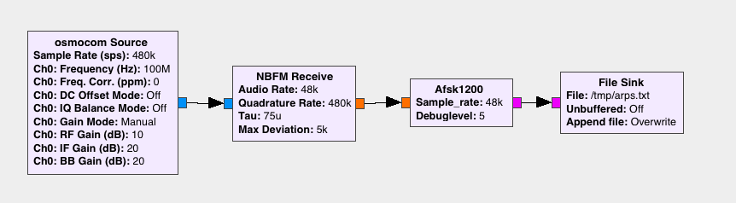
Basic Concept: Block
Written in C++ or Python
Implement one logical step
Each block run in separate thread
Can be encapsulated into hierarchical blocks

Slide 9
Data Streams
Samples are buffered
Data types are color-coded
Complex
Float
Byte

Slide 10
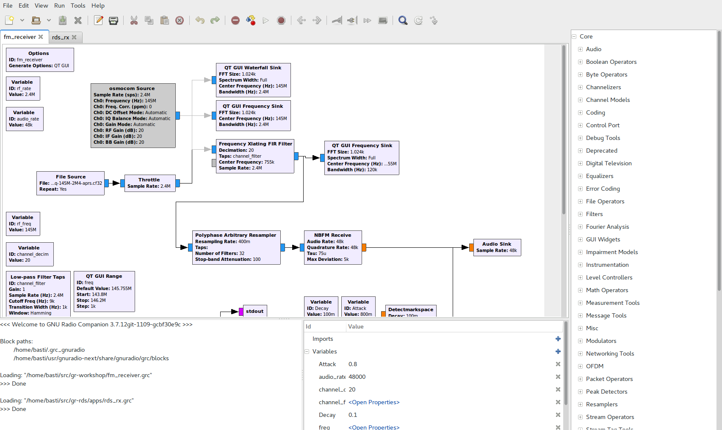
GNU Radio Companion
Block Library
Edit Flowgraph
Console
Variables

Slide 11
GUI Output and Instrumentation

Slide 12
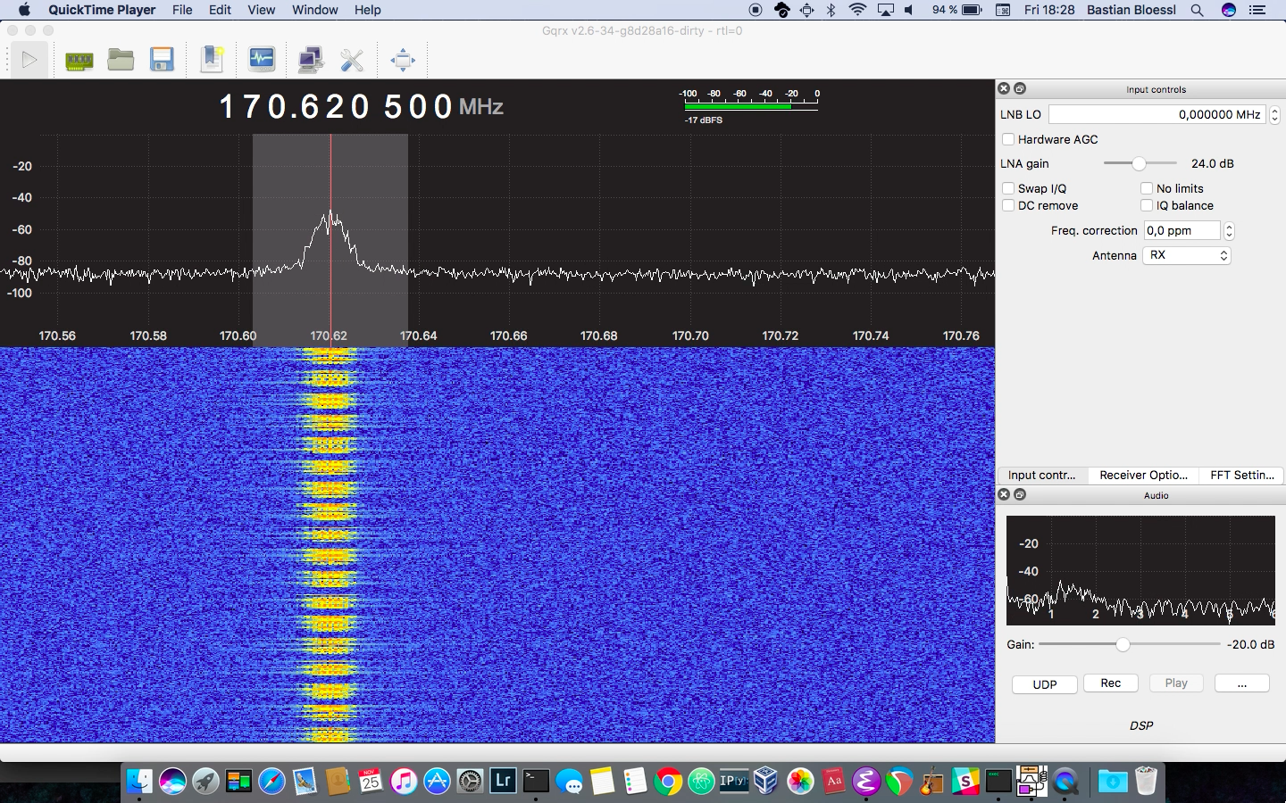
GQRX - a GNU Radio Application

Slide 13
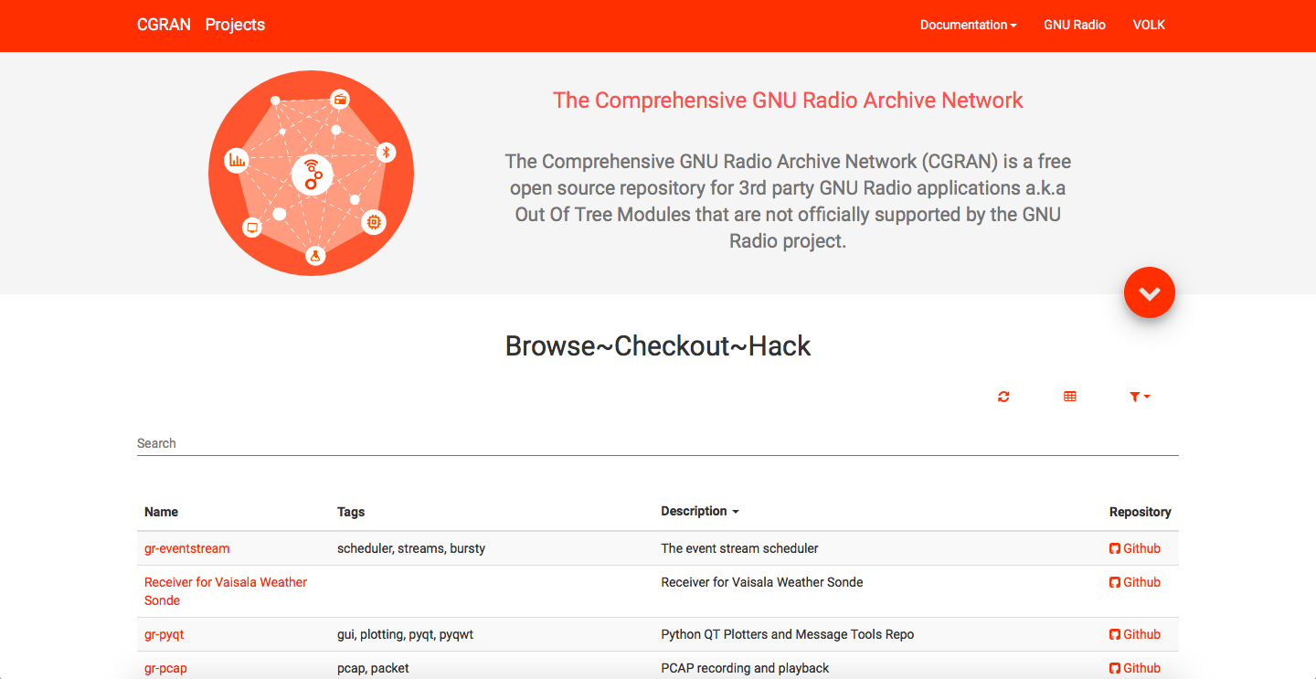
Out Of Tree Modules
GNU Radio can be extended with OOTs
OOTs cover more specific functionality
There is a large number available
CGRAN is our central database

Slide 14

GNU Radio is used by
Commercial
R&D
Defense
Research
Infosec
Research
Academic
Research
Hardware
Vendors
Professional
Service
Providers
Students
Hobbyists

Slide 15
GNU Radio is an Ecosystem
Active Open Source community
PyBombs, OOTs
GRCon
GNU Radio Foundation
FOSDEM SDR DevRoom
GSoC, SoCIS, R&S Competition, SDR Academy

Slide 16
Installing GNU Radio
From source: GitHub
Package manager
Some are pretty outdated
macOS / homebrew
PyBombs: integrated dependency management and 3rd party application installation

Slide 17
Learn // Discuss // Connect
Website: www.gnuradio.org
Development: github.com/gnuradio
Mailing List: discuss-gnuradio@gnu.org
Wiki: wiki.gnuradio.org
Slack: slack.gnuradio.org
Facebook: gnuradioproject
Twitter: @gnuradio

Slide 18




GNU Radio Workshop
Marcus Müller Bastian Bloessl
@dEnergy_dTime
www.bastibl.net
@bastibl.net

